Slide 1

Capstone Project Unsupervised ML - Clustering
NETFLIX MOVIES AND TV SHOWS CLUSTERING
By
Deepak Dobal

Slide 2
Problem statement
This dataset consists of tv shows and movies available on Netflix as of 2019. The dataset is collected from Flixable which is a third-party Netflix search engine.
In 2018, they released an interesting report which shows that the number of TV shows on Netflix has nearly tripled since 2010. The streaming service’s number of movies has decreased by more than 2,000 titles since 2010, while its number of TV shows has nearly tripled. It will be interesting to explore what all other insights can be obtained from the same dataset.
Integrating this dataset with other external datasets such as IMDB ratings, rotten tomatoes can also provide many interesting findings.
In this project, I have done
1.Exploratory Data Analysis
2.Understanding what type content is available in different countries
3.Is Netflix increasingly focusing on TV rather than movies in recent years.
4.Clustering similar content by matching text-based features

Slide 3
Points to discuss
Data description
Exploratory data analysis
Hypothesis testing
Feature selection
Machine learning algorithms(unsupervised)
K-mean
agglomerative clustering
Model performance
Conclusion

Slide 4
Data description
The dataset consists of listings of all the movies and tv shows available on Netflix, along with details such as - cast, directors, ratings, release year, duration, etc
show_id : Unique ID for every Movie / Tv Show
type : Identifier - A Movie or TV Show
title : Title of the Movie / Tv Show
director : Director of the Movie
cast : Actors involved in the movie / show
country : Country where the movie / show was produced
date_added : Date it was added on Netflix
release_year : Actual Release Year of the movie / show
rating : TV Rating of the movie / show
duration : Total Duration - in minutes or number of seasons
listed_in : Genre
description: The Summary description

Slide 5
Understanding the data:
To increase the efficiency of our analysis we will first have to understand the data and also check if there are some corruptions in the data and if any found we will try to treat it.
This dataset consists of tv shows and movies available on Netﬂix as of 2019.
It has 7787 observations and 12 features(columns).
The dataset consists of eleven textual columns and one numeric column(‘release_year’ )

Slide 6




Initial preparation
Pandas for data manipulation, aggregation.
Matplotlib and Seaborn for visualization and behavior with respect to the target variable.
NumPy for computationally efficient operations.
Scikit Learn for model training, model optimization, and metrics calculation format.
NLTK to preprocess text data for further analysis like with ML models for instance

Slide 7
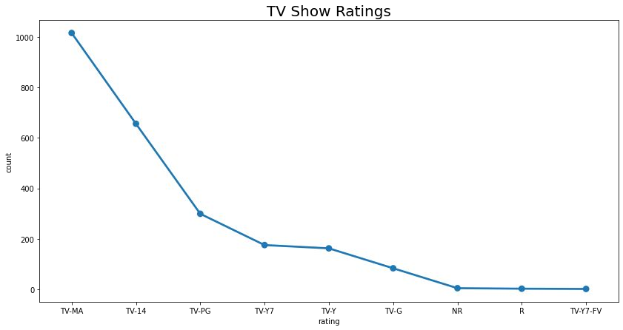
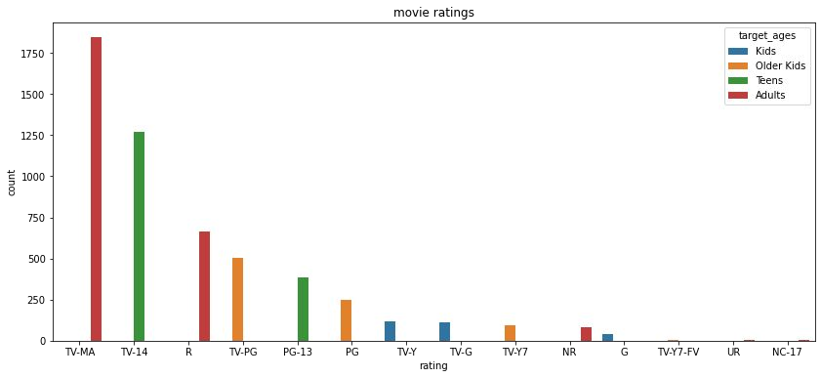
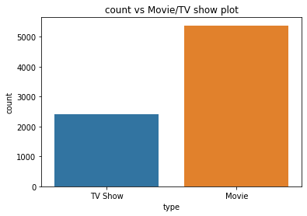
Type
EDA
Ratings
Netflix has 5372 movies and 2398 TV shows,there are more number movies on Netflix than TV shows.
TV-MA has the highest number of ratings for tv shows i,e adult ratings
TV-MA has the highest number of ratings for movies i,e adult ratings
in both the cases TV-MA has the highest number of ratings

Slide 8
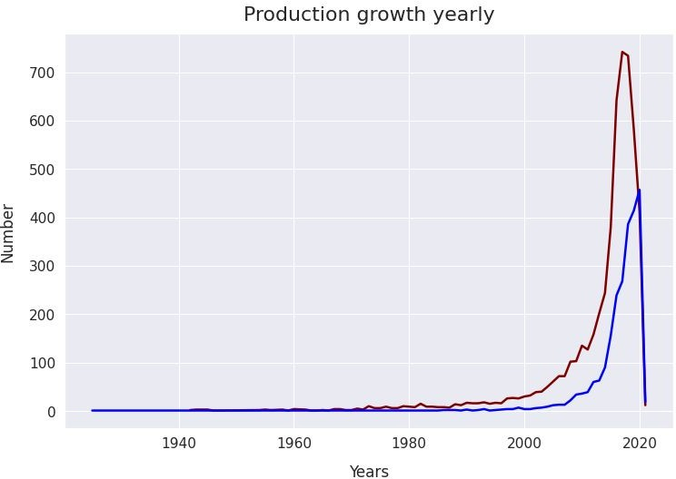
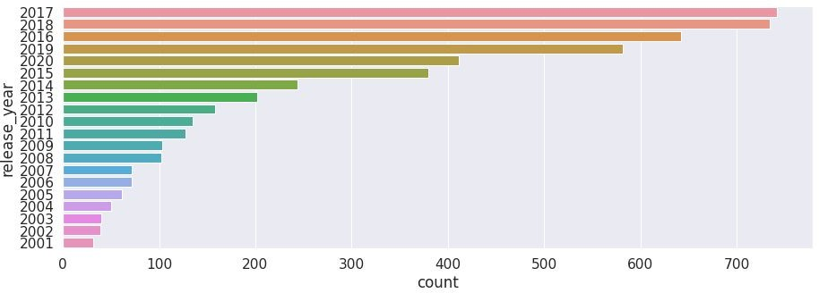
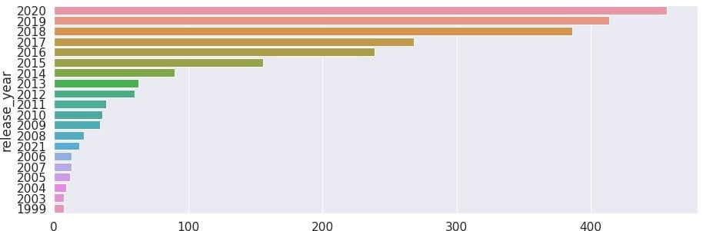
Release year
EDA
movies
highest number of movies released in 2017 and 2018
highest number of TV Show released in 2020
The number of movies on Netflix is growing significantly faster than the number of TV shows.
We saw a huge increase in the number of movies and television episodes after 2015.
there is a significant drop in the number of movies and television episodes produced after 2020.
It appears that Netflix has focused more attention on increasing Movie content that TV Shows. Movies have increased much more dramatically than TV shows.
tv_shows

Slide 9
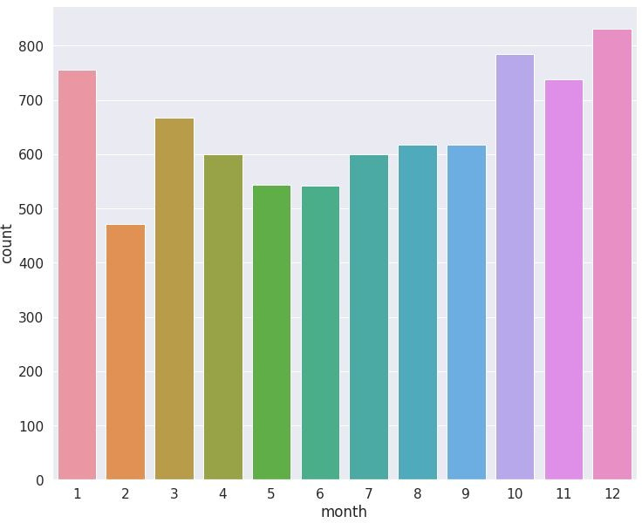
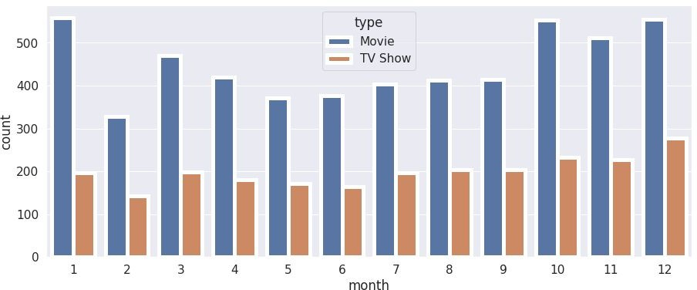
Release month
Highest number of movies released in 2017 and 2018
Highest number of TV Shows released in 2020
The number of movies on Netflix is growing significantly faster than the number of TV shows.
We saw a huge increase in the number of movies and television episodes after 2015.
It appears that Netflix has focused more attention on increasing Movie content that TV Shows. Movies have increased much more dramatically than TV shows.

Slide 10
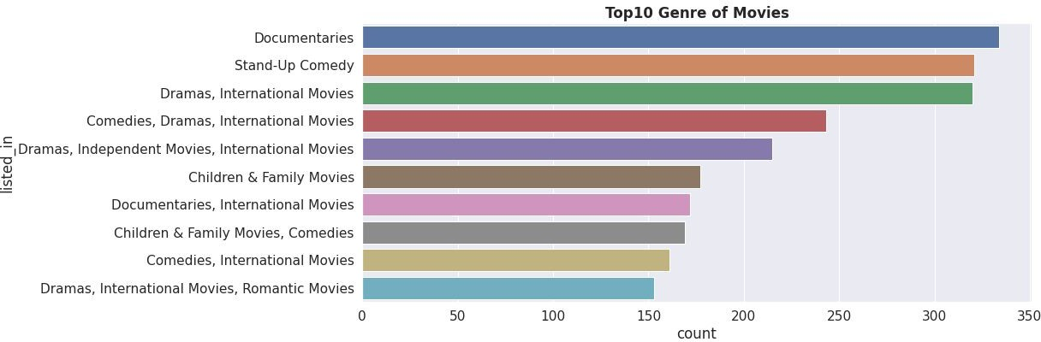
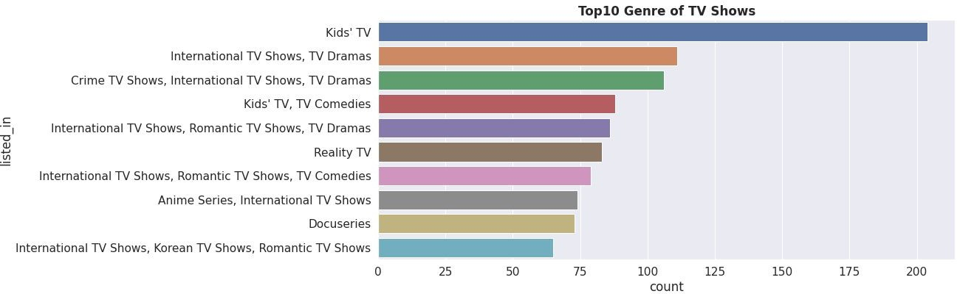
genre
Documentaries are the top most genre in netflix which is fllowed by standup comedy and Drams and international movies
kids tv is the top most TV show genre in netflix

Slide 11
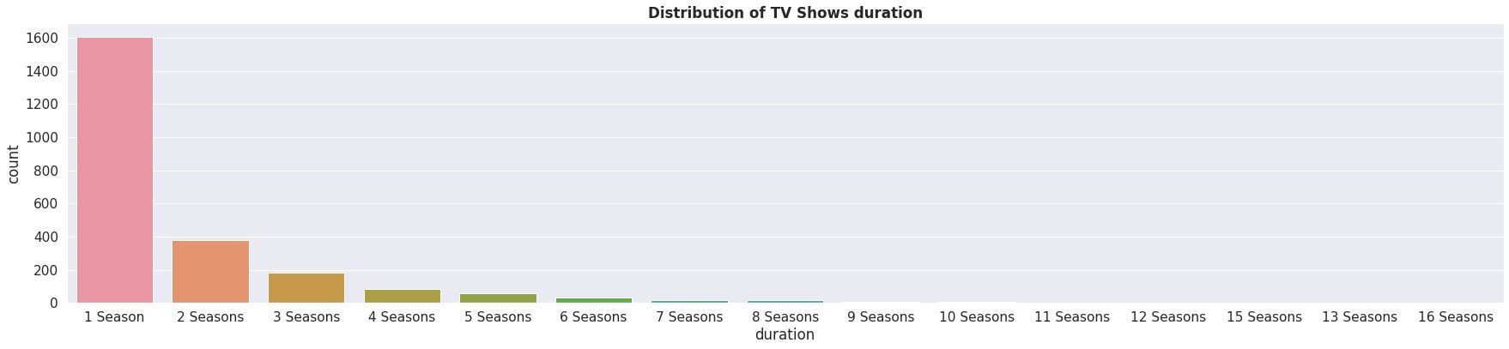
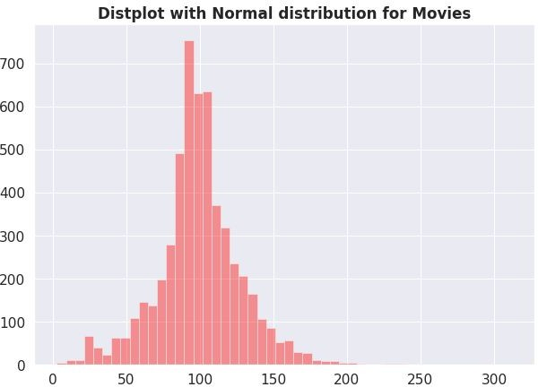
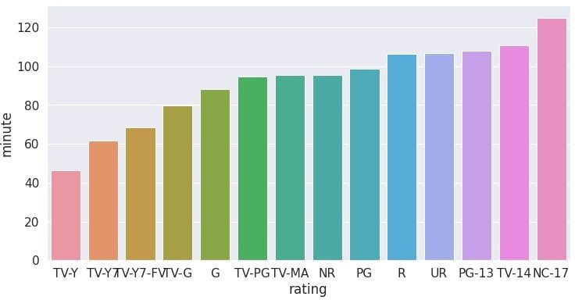
Duration
highest number of tv_shows consistig of single season
most of the movies have duration of between 80 to 130
.
Those movies that have a rating of NC-17 have the longest average

Slide 12
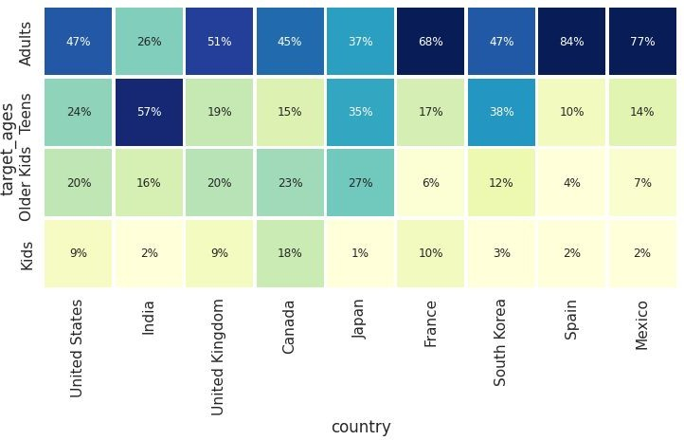
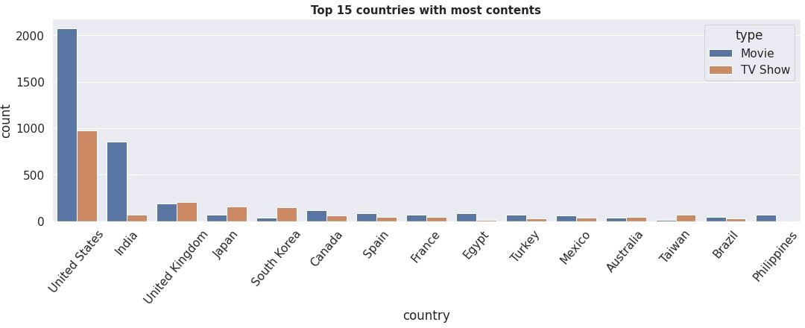
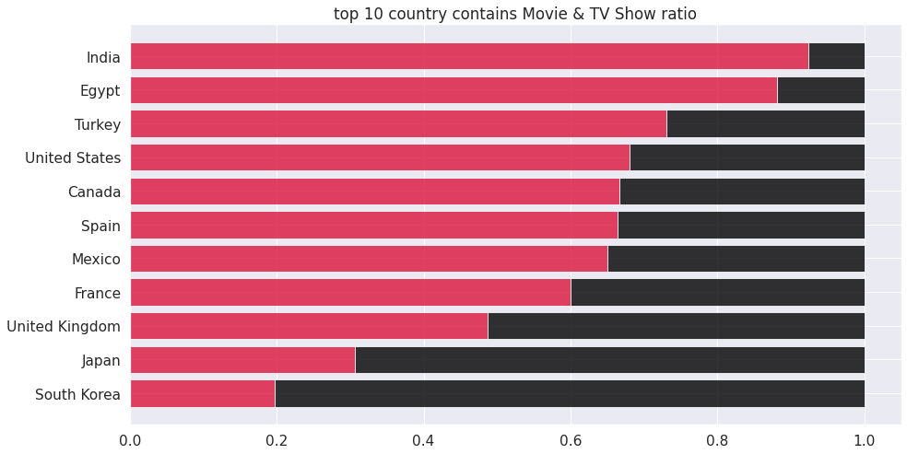
Country
unitated states has the highest number of content on the netflix ,followed by india
the US and UK are closely aligned with their Netflix target ages, but radically different from, example, India or Japan!
Also, Mexico and Spain have similar content on Netflix for different age groups.
India has highest number of movies but lowest number of TV shows in netflix while korea has lowest No of movies and hight number of TV shows

Slide 13
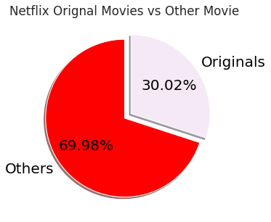
Originals
30% movies released on Netflix were Netflix Orignal.
70% movies added on Netflix were Rented.

Slide 14
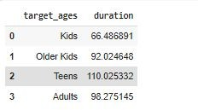
1.HYPOTHESIS TESTING
Hypothesis testing in statistics refers to analyzing an assumption about a population
parameter.
HO:movies rated for kids and older kids are on Average least two hours long.
H1:movies rated for kids and older kids are not at least two hours long Average running time.
the t-value is not in the range, the null hypothesis is rejected.
As a result, movies rated for kids and older kids are not at least two hours long.

Slide 15
2. H1:The mean duration which is more than 90 mins are movies HO:The mean duration which is more than 90 mins are NOT movies
.
.
the t-value is not in the range, the null hypothesis is rejected.
As a result, The duration which is more than 90 mins are movies

Slide 16
Features selection
Initially Separating the column type into movie and tv shows
here we are going to do Clustering similar content by matching text-based features so column description is one of the important feature
Convert the text to lower case
Tokenize the text
Removed all the stop words and punctuation
we use TF-IDF is an abbreviation for Term Frequency Inverse Document Frequency. This is very common algorithm to transform text into a meaningful representation of numbers which is used to fit machine algorithm for prediction

Slide 17
ML algorithms(unsupervised
K-mean
agglomerative clustering

Slide 18
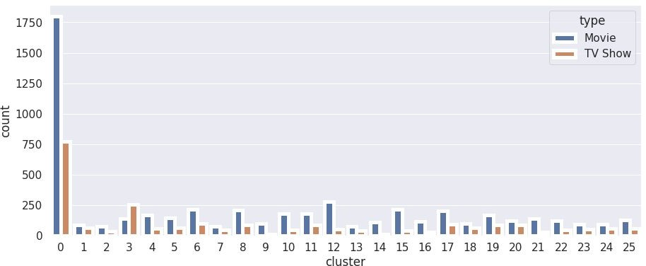
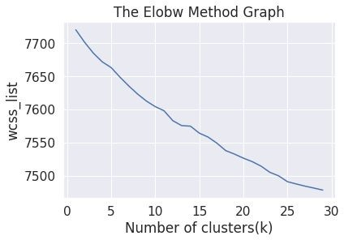
K-Means:
K-Means Clustering is an Unsupervised Learning algorithm which groups the unlabeled dataset into different clusters. Here K defines the number of predefined clusters that need to be created in the process, as if K=2, there will be two clusters, and for K=3, there will be three clusters, and so on.
Elbow Method
Result:
cluster 0 has the highest number
of datapoints and evenly
From elbow method generating 26 clusters
distributed for other cluster

Slide 19
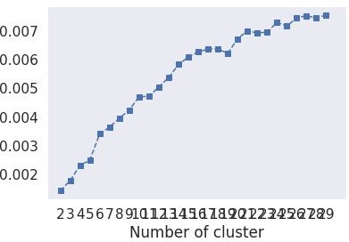
evaluation
1.Silhouette Score : is a metric to evaluate the performance of clustering algorithm. It uses
compactness of individual clusters(intra cluster distance) and separation amongst clusters (inter
cluster distance) to measure an overall representative score of how well our clustering algorithm
has performed
2.The Davies-Bouldin index (DBI ).It is most commonly used to evaluate the goodness of split
by a K-Means clustering algorithm for a given number of clusters.
silhouette score would always lie between -1 to 1. 1
representing better clustering
Silhouette score is 0.007499010681200968
Davies_bouldin_score is 9.05605194948868
so model is performing well

Slide 20
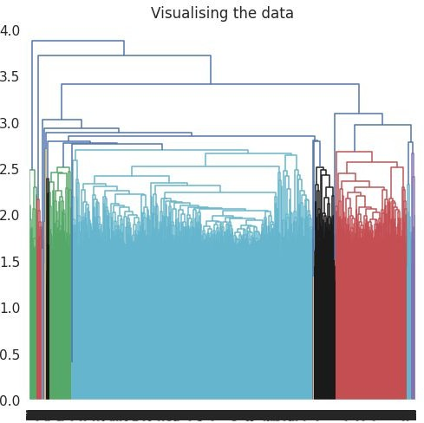
2.Agglomerative Clustering
In agglomerative clustering no need to give the value of k beforehand
The agglomerative hierarchical clustering algorithm is a popular example of HCA
Here I used ward linkage
the optimal number of clusters is 4 using the Dendrogram
Evaluation
Silhouette Coefficient: -0.002
Davies_bouldin_score is 9.05605
Comparing with K mean only Davies_bouldin_score is better for hierarchical clustering Model is not performing well

Slide 21
Conclusion
from elbow and sillhoute score ,optimal of 26 clusters formed , K Means is best for identification than Hierarchical as the evaluation metrics also indicates the same.In kmean cluster 0 has the highest number of datapoints and evenly distributed for other cluster
Netflix has 5372 movies and 2398 TV shows, there are more movies on Netflix than TV shows.
TV-MA has the highest number of ratings for tv shows i,e adult ratings
highest number of movies released in 2017 and 2018 highest number of movies released in 2020 The number of movies on Netflix is growing significantly faster than the number of TV shows. We saw a huge increase in the number of movies and television episodes after 2015. there is a significant drop in the number of movies and television episodes produced after 2020. It appears that Netflix has focused more attention on increasing Movie content than TV Shows. Movies have increased much more dramatically than TV shows

Slide 22
the most content is added to Netflix from october to january
Documentaries are the top most genre in netflix which is followed by standup comedy and Drama and international movies
kids tv is the top most TV show genre in netflix
most of the movies have duration of between 80 to 130
highest number of tv_shows consisting of single season
Those movies that have a rating of NC-17 have the longest average duration.
When it comes to movies having a TV-Y rating, they have the shortest runtime on average
united states has the highest number of content on the netflix ,followed by india
india has highest number of movies in netflix
30% movies released on Netflix. 70% movies added on Netflix were released earlier by different mode.

Slide 23
Thank you

